Slide 1
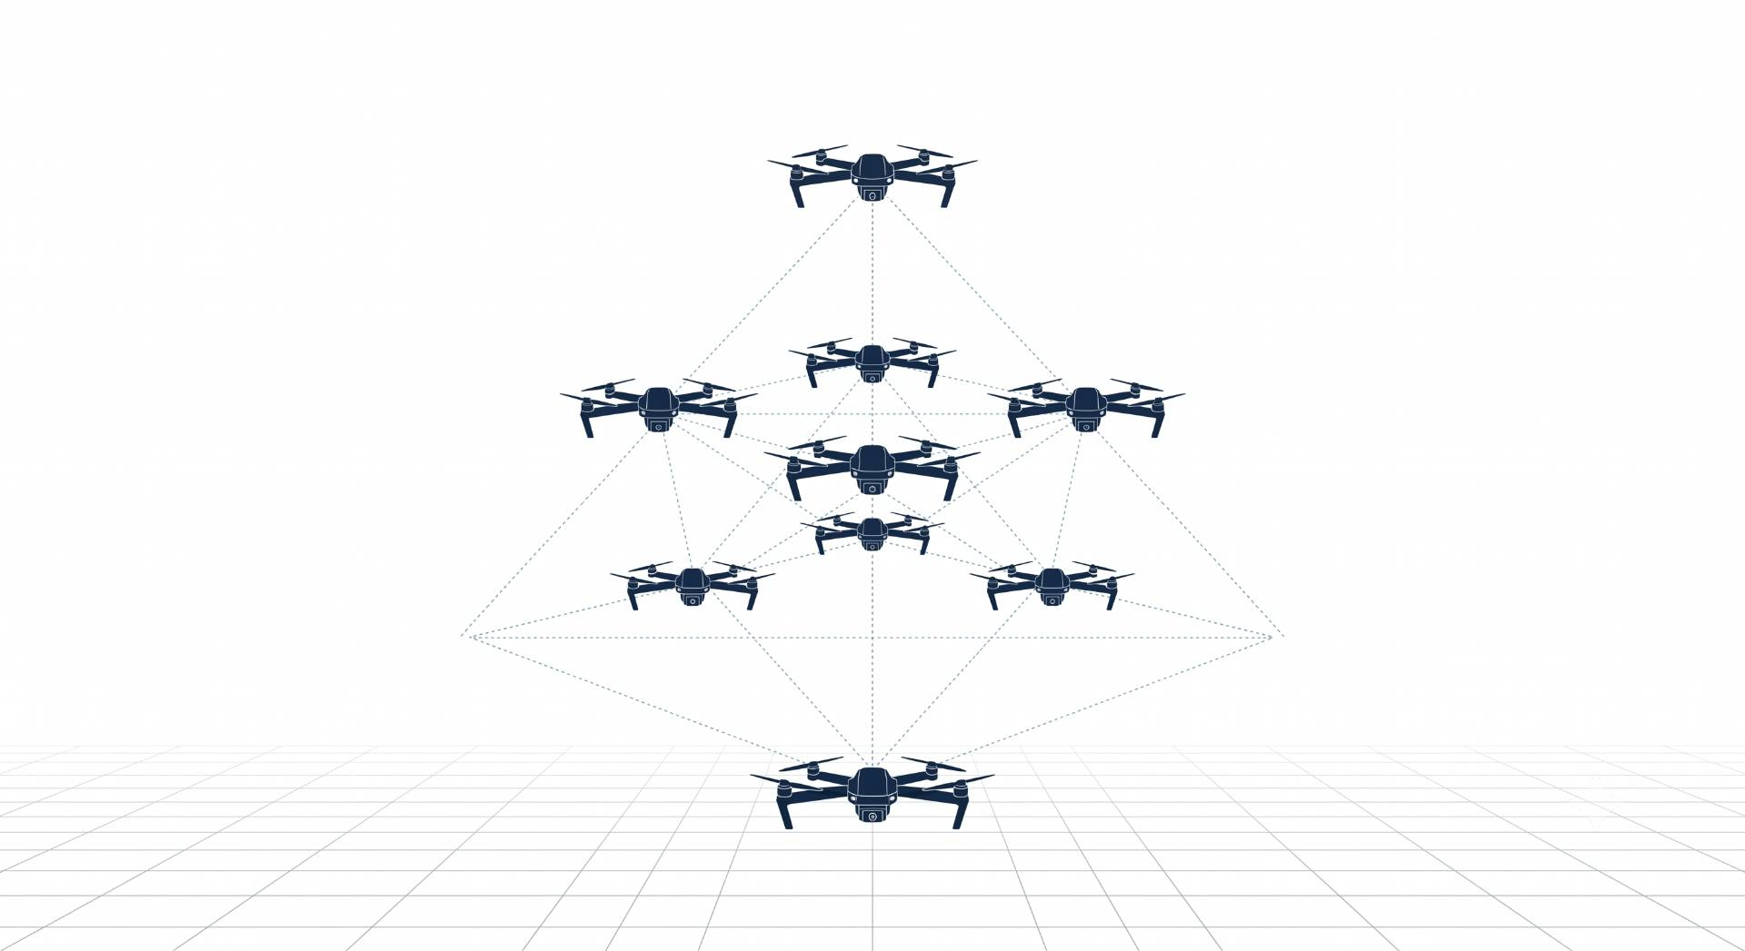

Dynamic Target Assignment and Collision Avoidance for Multi-UAV Coordination in 3D using MARL
Ayesha Khalil, CIIT/SP25-RCS-009/ATD
Supervisor: Dr. Faisal Rehman Co-supervisor: Dr. Ehzaz Mustafa

Slide 2
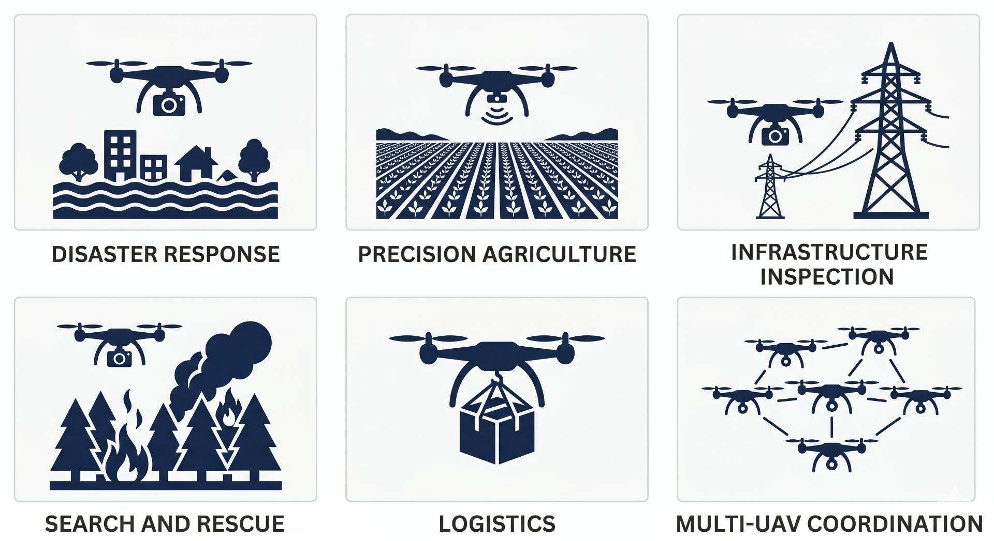
Introduction: Why UAVs?
From military tools to critical civilian infrastructure
UAVs now used in disaster response, agriculture, inspection
Single drone cannot cover complex, large-scale missions
Teams of drones are faster, redundant, and more effective
Hardware is ready coordination is the unsolved problem

Slide 3
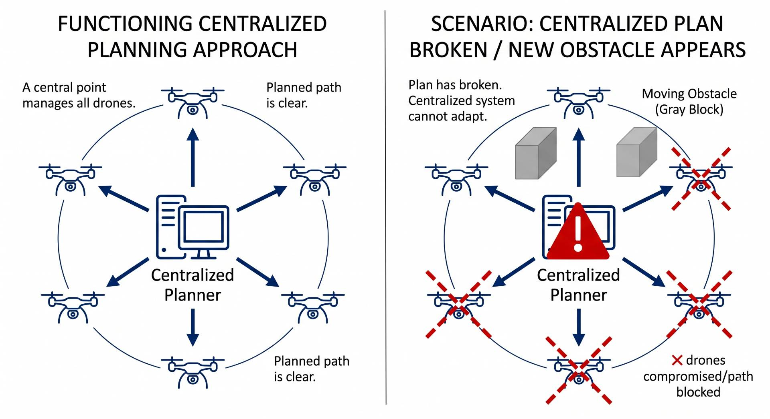
Introduction: Multi-UAV Coordination
Multiple drones, shared airspace, conflicting decisions
Classical planners compute one global solution too slow
Dynamic environments break pre-planned paths instantly
Drones need to adapt in real-time, independently
Solution: let drones learn coordination through experience

Slide 4
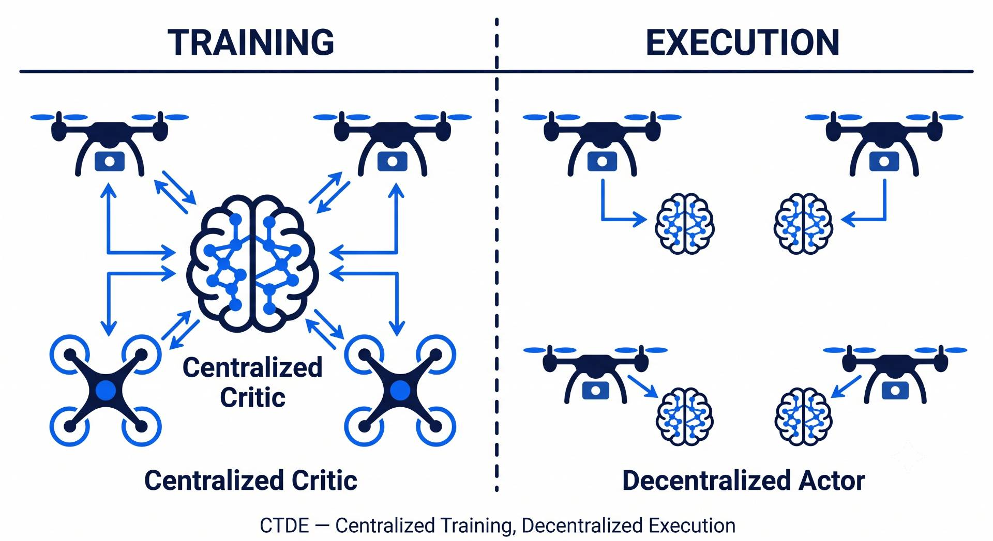
Introduction: DRL & MARL
Learning-based coordination how it works
DRL: agent receives reward, learns optimal policy
MARL: extends DRL to teams of cooperating agents
CTDE Architecture: train with shared info, execute independently
MAPPO (Multi-Agent PPO): best-performing cooperative MARL algorithm

Slide 5
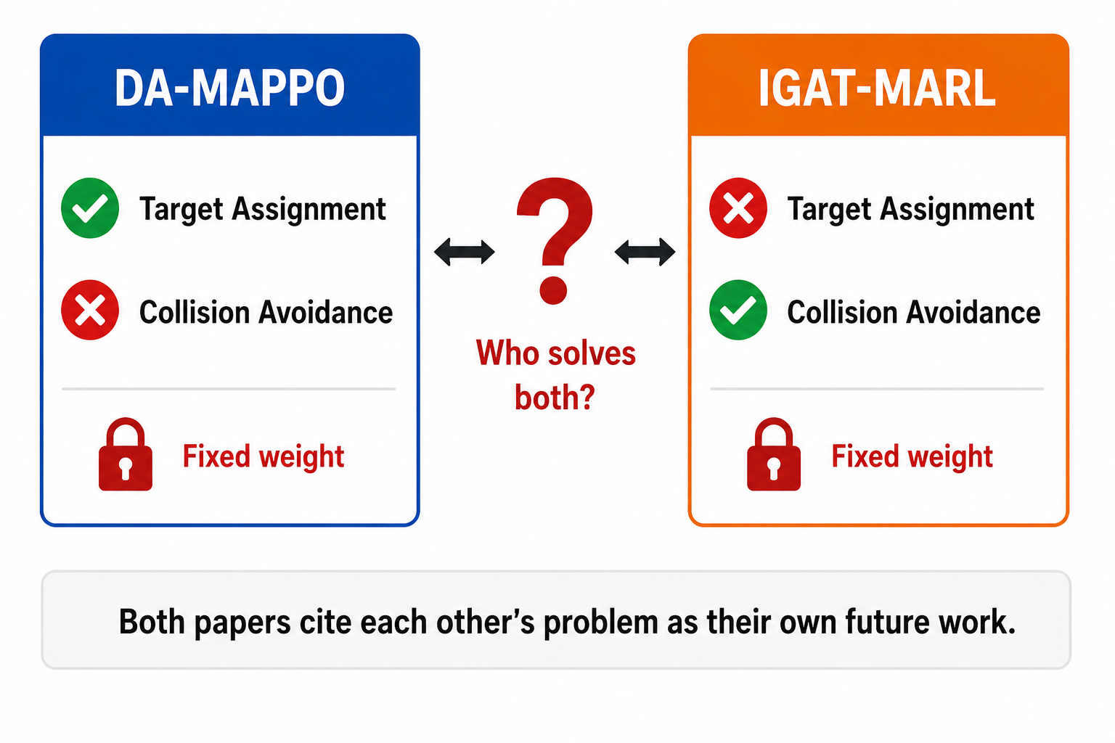
Motivation:
Two halves of the same problem
DA-MAPPO achieves 90–99% mission success, zero collision avoidance
IGAT-MARL reduces interaction edges by 44%, zero target assignment
DA-MAPPO ablation: removing assignment information causes success to drop from 90% → 0%
Both use fixed, hand-tuned reward weights never adapt
No framework learns when to prioritize which objective

Slide 6
Related Work:
Authors | Contribution | Methodology | Dataset/Sample | Strength | Limitation
Govinda, Brik & Harous (2025) | Systematic review of DRL for UAV, robotics, transportation | Literature survey across published DRL studies | Published papers (no primary data) | Identifies lack of unified frameworks as the key open gap | Survey only — no new algorithm proposed
Tang, Liang & Li (2024) | Single UAV navigation in dynamic obstacle environments | Improved D3QN + Prioritized Experience Replay + heuristic action bias | Custom 2D sim, single UAV, moving obstacles | 95% success rate, outperforms A* and RRT | Single drone only, 2D, discrete actions
Kong, Zhou, Li & Wang (2024) | Joint target assignment + path planning for multi-UAV | TANet-TD3 + Hungarian algorithm supervision + POMDP | Custom 2D sim, 5 UAVs, moving targets | First paper combining assignment + path planning | 2D only, no inter-drone collision avoidance
Jarray, Zaghbani & Bouallègue (2025) | UAV path planning in large-scale 3D environments | DQN + 3D CNN + dynamic reward formula | Custom 3D sim, 25 km² area, 4 obstacle densities | 98% success in 3D, beats PSO and GWO | Single drone, static obstacles only

Slide 7
Related Work Cont…
Authors | Contribution | Methodology | Dataset/Sample | Strength | Limitation
Rezaee et al. (2026) — IGAT-MARL | Collision avoidance using sparse conflict-aware interaction graph | Conflict-driven sparse graph + Improved GAT + curriculum | BlueSky sim, 3–10 fixed-wing UAVs, conflict-guaranteed episodes | 44% fewer edges, 17% higher reward, 10% fewer dangerous events | No target assignment — drones have no goals
Sheng et al. (2026) — DA-MAPPO | Real-time dynamic target assignment embedded in drone observation | Hungarian algorithm at every step + MAPPO + 4-tier reward + curriculum | Custom sim, 3 UAVs, 3 dynamic targets, 30–50 static obstacles | 90–99% mission success, robust to 50% packet loss and 6-step delay | 2D only, 3 drones only, no inter-drone collision avoidance
Zhang et al. (2025) | Large-scale UAV swarm navigation with mean-field RL | Mean-field DDPG + multi-head attention + CTDE | Custom 2D sim, 20–120 UAVs, static obstacles | >90% success at 120 drones where baselines collapse | 2D only, static obstacles, homogeneous drones
Xu et al. (2026) — MRLMN | UAV multi-hop networking with LLM-guided MARL | GPT-4o knowledge distillation + IPPO + role-based reward decomposition | Custom sim, 12–24 UAVs, 150 ground users | 52% higher data rate, 27% more user coverage | 2D only, GPT-4o dependency, no energy modeling

Slide 8
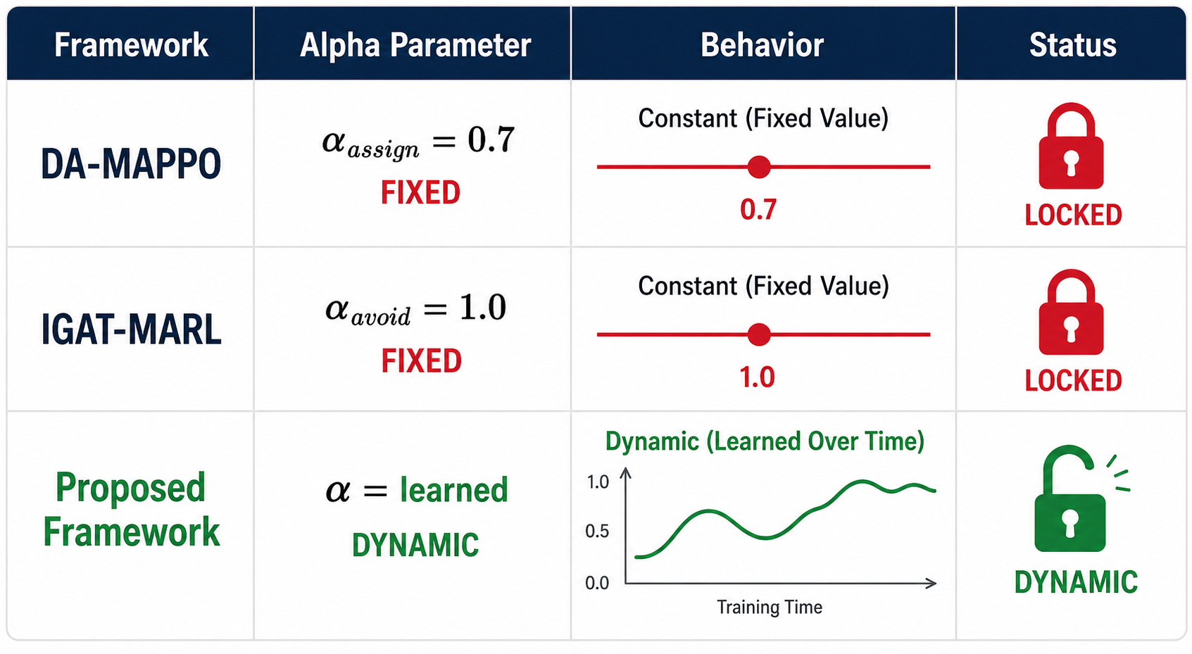
Gap in existing work:
Assignment and avoidance always studied in isolation
No single learned policy handles both simultaneously
All frameworks use fixed coefficients set before training
Assignment weight and avoidance weight never change mid-mission
No mechanism exists to learn priority this is the gap

Slide 9
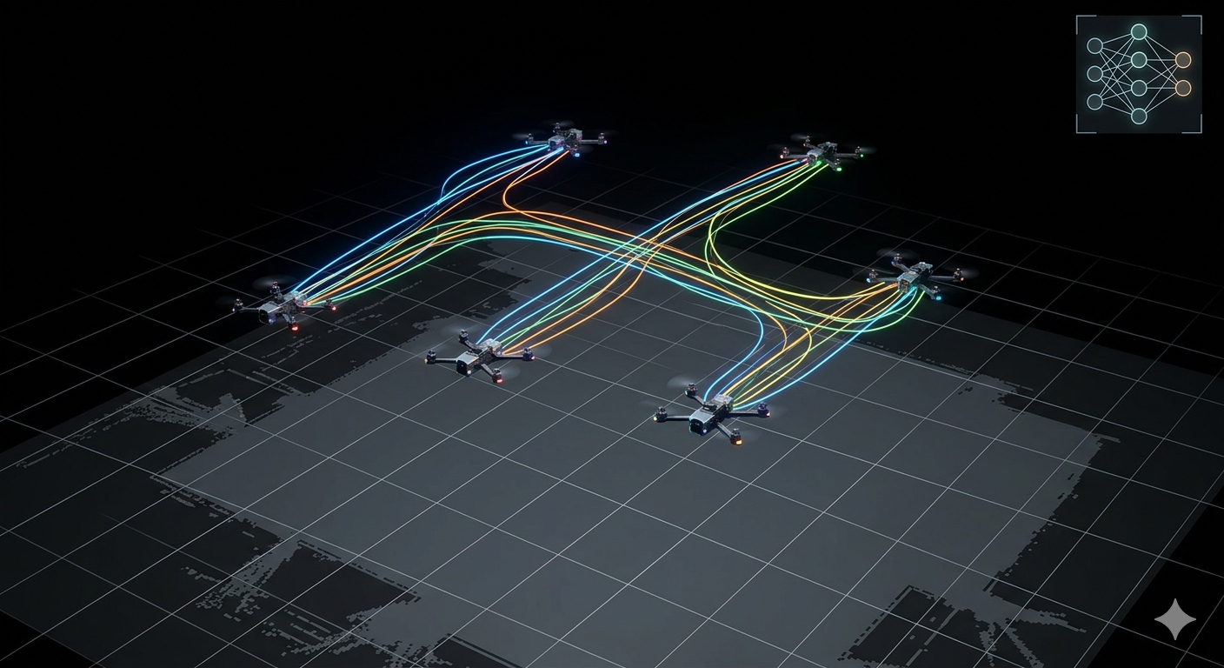
Problem Statement:
In multi-UAV cooperative missions, task allocation and collision avoidance are interdependent, a UAV's path to its assigned target directly affects its proximity to other UAVs, and any safety-driven course correction changes whether that target remains reachable. This interdependence means a single avoidance maneuver can leave a critical target uncovered, trigger reassignment conflicts across the swarm and create new collision risks simultaneously. Despite being the two most studied problems in multi-UAV coordination, task allocation and collision avoidance have never been addressed together within a single learned policy.

Slide 10
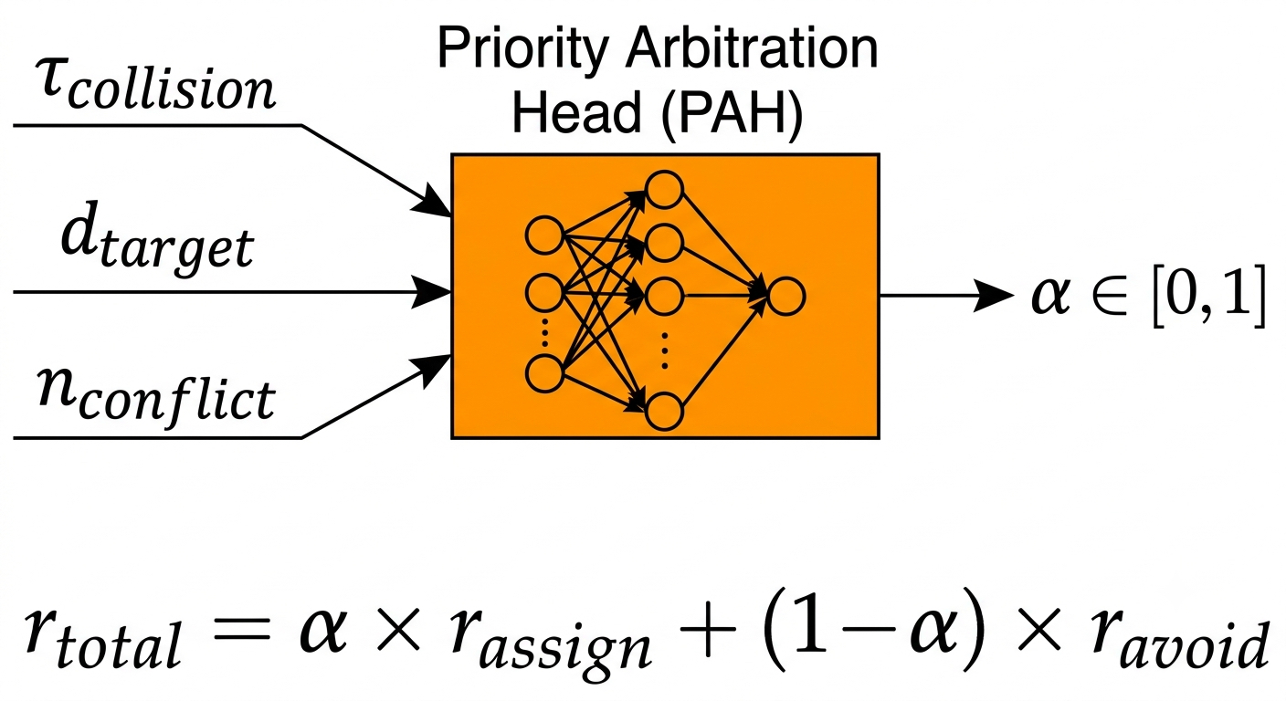
Research Objective
Design the Priority Arbitration Head (PAH) jointly trained with MAPPO
Scale testing: 3 → 5 → 8 drones, measure performance drop
Ablation: learned α vs fixed α at 0.3, 0.5, 0.7
Find failure boundary: swarm size, density, speed limits

Slide 11
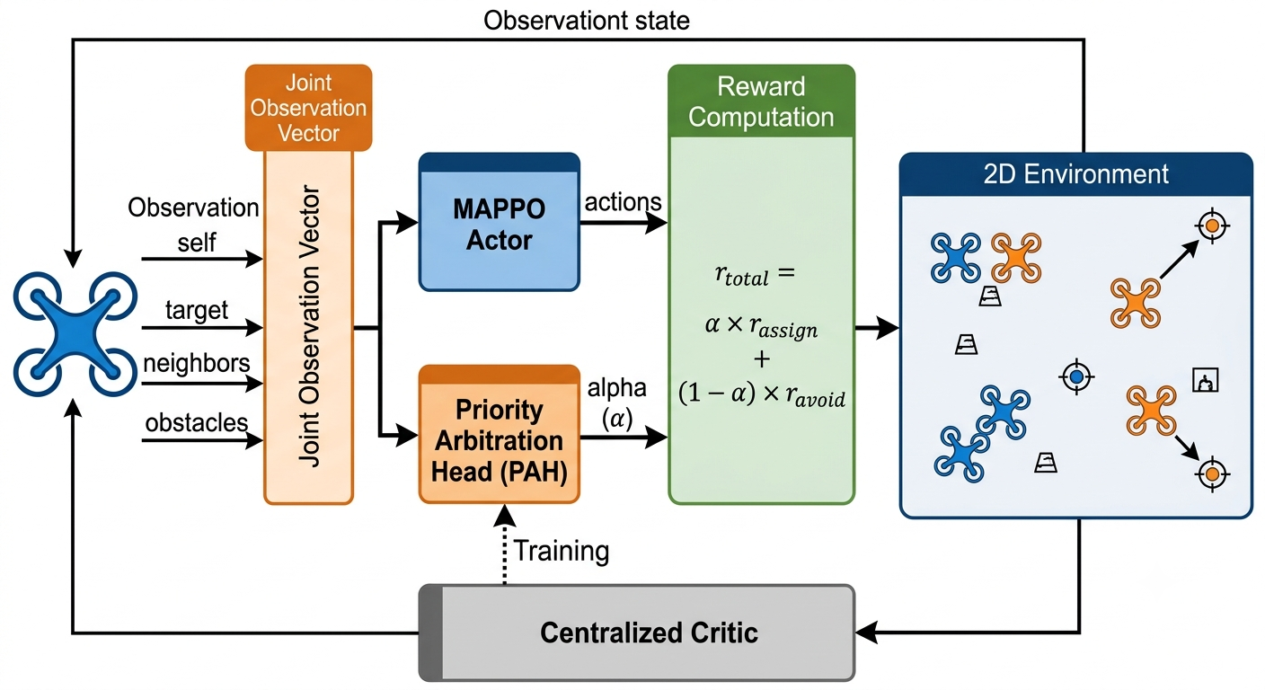
Proposed Methodology:
.

Slide 12
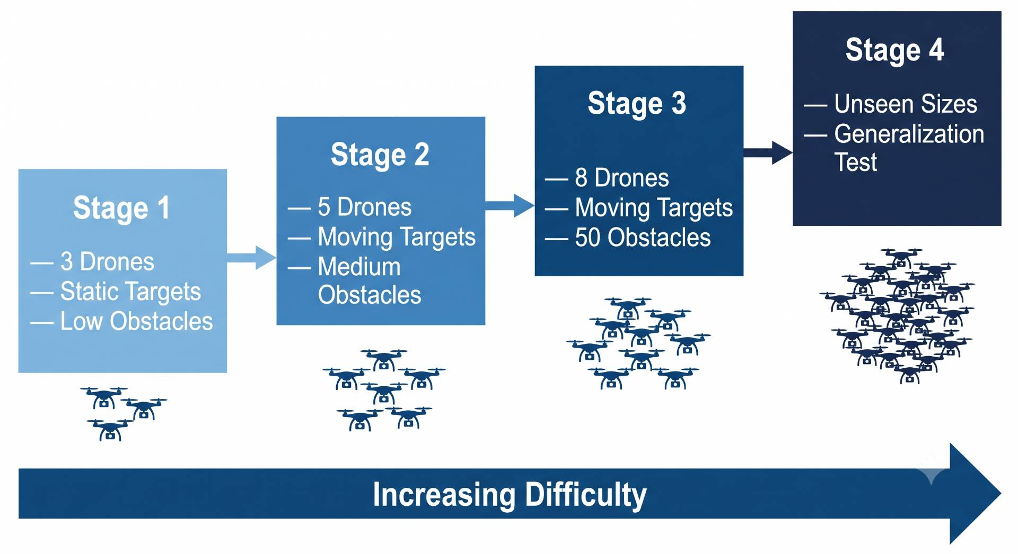
Training Strategy:
Stage | Drones | Obstacles | Goal
1 | 3 | Low | Replicate DA-MAPPO baseline in 2D
2 | 5 | Medium | Assignment + avoidance together
3 | 8 | 50 (high) | Full challenge
4 | Unseen sizes | Various | Generalization

Slide 13
References:
S. Govinda, B. Brik, and S. Harous, "A survey on deep reinforcement learning applications in autonomous systems," IEEE Trans. Intell. Transp. Syst., vol. 26, no. 7, 2025.
J. Tang, Y. Liang, and K. Li, "Dynamic scene path planning of UAVs based on deep reinforcement learning," Drones, vol. 8, no. 2, p. 60, 2024.
X. Kong, Y. Zhou, Z. Li, and S. Wang, "Multi-UAV simultaneous target assignment and path planning based on deep reinforcement learning in dynamic multiple obstacles environments," Front.Neurorobot., vol. 17, p. 1302898, 2024.
R. Jarray, I. Zaghbani, and S. Bouallègue, "Dynamic reward-based deep reinforcement learning algorithm for UAV path planning in large-scale environments," Procedia Comput. Sci., vol.270, pp. 692–702, 2025.
M. R. Rezaee, N. A. W. A. Hamid, M. Hussin, and Z. A. Zukarnain, "Efficient multi-agent deep reinforcement learning algorithm for multi-UAV collision avoidance," Appl. Soft Comput., vol.197, p. 115145, 2026.
Y. Sheng, X. Xie, H. Liu, and J. Li, "Dynamic target assignment and cooperative decision-making for UAV swarms based on multi-agent reinforcement learning," IEEE Internet Things J., doi:10.1109/JIOT.2026.3686066, 2026.
Y. Zhang et al., "Large-scale UAV swarm path planning based on mean-field reinforcement learning," Chin. J. Aeronaut., vol. 38, no. 9, p. 103484, 2025.
Y. Xu et al., "Scalable UAV multi-hop networking via multi-agent reinforcement learning with large language models," arXiv:2505.08448, 2026.

Slide 14
Thank you!

